Slide 1
WILKINS DEMAND FORECASTING
Presented by Madhuri Malgareddy

Slide 2

Introduction
Wilkins Regulator Company specializes in producing high-quality plumbing products, including water pressure-reducing valves, backflow preventers, and anti-scald shower valves.
Its market scope spans new home constructions, remodeling of older houses, and various construction projects.
The current sales data available for Wilkins' products covers the period from January 2001 to December 2004.

Slide 3

Objective
Develop various forecasting models to predict the demand for two of Wilkins' product families, PBV and Fire Valves.
Compare Wilkins' existing forecasting model with the newly developed models and provide recommendations based on the findings.

Slide 4
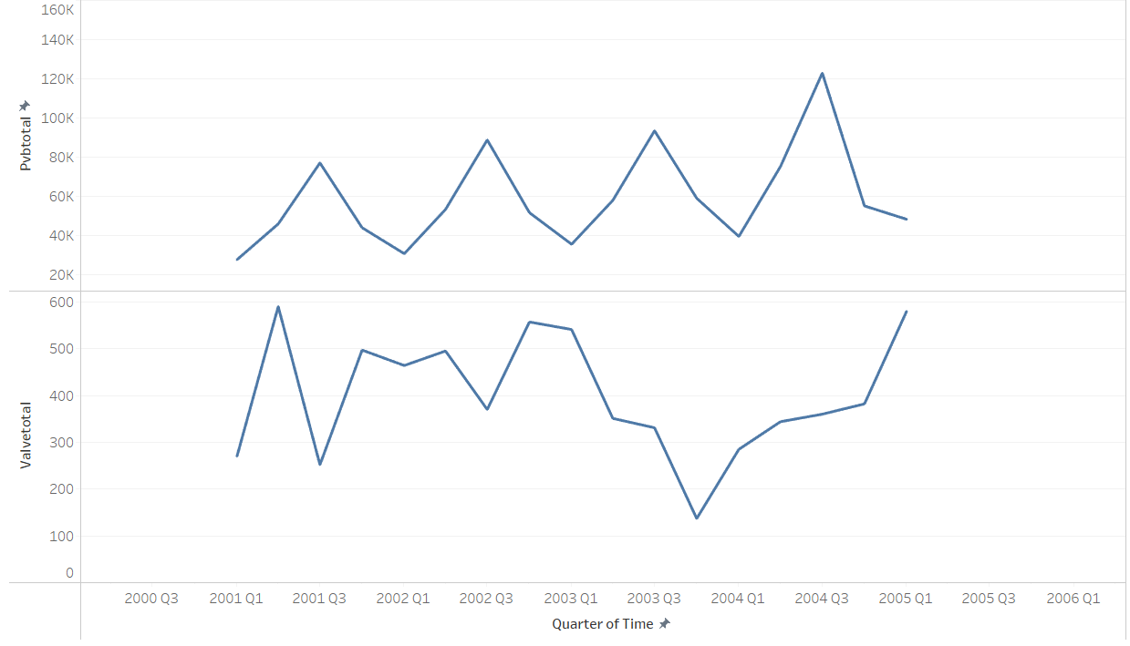
Seasonality
PVB sales appear to exhibit seasonality, with higher demand during specific seasons.
Notably, sales in Quarter 3 of each year are consistently higher compared to other quarters.
In contrast, Fire Valve sales decline during Quarter 3, also indicating a seasonal pattern.

Slide 5
Forecasting method used by Wilkins
Time-Series Data Usage:
The "forecast master" spreadsheet lists historical weekly sales data for each product family by quarter and year since 1999.
The method averages these historical weekly sales data for 13 weeks per quarter to estimate quarterly sales.
Decomposition and Aggregation:
The planning bill involves calculating daily and annual averages based on historical sales figures and multiplying these averages by a standardized factor (e.g., 250 days per year).
Judgmental Adjustments:
Adjustments are made for specific products, considering external factors like industry trends, market conditions, and product-level details (e.g., new product introductions or competitor issues).
Scenario-Based Projections:
Projections include forecasting based on "raw percentages" (current sales mix within the family) and "planning bill percentages" (adjusted future sales proportions).

Slide 6
Why forecasting is important
Sales and Marketing Teams
Supply Chain and Inventory Management
Production and Manufacturing.
Finance

Slide 7

Inaccurate Forecasting
Overstocking (Excess Inventory)
Understocking (Stockouts)
Production Issues
Financial Impacts
Reputation Damage

Slide 8
Metrics for 2005 Q1
Forecasted Sales:
1. PVB Units: 53,560
2.Fire Valve Units: 559
Actual Sales:
1.PVB Units: 48,159
2.Fire Valve Units: 580
MAE: 2711 units
MAPE: 7.42%
Conclusion:
This indicates that the demand forecast was relatively accurate, with an average deviation of around 7.42%.

Slide 9
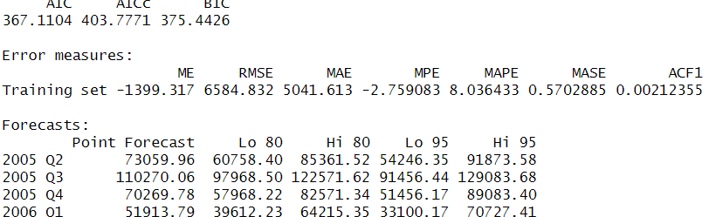
Demand Forecast for PVB -2005(Q2,Q3,Q4)
Models experimented with Wilkins data
Holt model damped
Holt winter damped
Exponential smoothing
Tableau
Of all the models Holt winters model has low MAPE and closer to Wilkin’s MAPE
When compared to Wilkin’s forecasting method all these models have higher MAPE values indicating Wilkin’s have better forecasting results compared to above Models forecast.

Slide 10
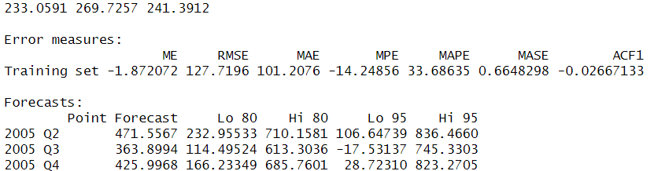
Demand Forecast for Fire Valve= 2005(Q2,Q3,Q4)
Same models are used to forecast Fire Valves demand as well
MAPE values are very high compared to PVB MAPE values
Holt winters damped model have better forecasts than other models
Wilkins forecast is better than models used in case of Valves

Slide 11
Recommendations
Wilkin’s current forecasting model does not take into account key economic factors such as the unemployment rate, bank loans, and housing starts (both single and multi-unit).
However, when evaluating the use of multiple regression, it was found that the unemployment rate and bank loans were not significant predictors, as evidenced by their high p-values (greater than 0.05). This suggests that these variables do not have a strong influence on the forecasting results.
On the other hand, the variable for single-unit housing starts showed a very low p-value, indicating that it is a highly significant factor in the forecast model.
We suggest that Wilkin’s forecasting model incorporate single-unit housing starts as an additional variable. Doing so would likely enhance the accuracy of the forecasts, as this factor has been shown to have a meaningful impact.

